Slide 1

FORWARD PASS
Supposed that the neurons have a sigmoid activation function, perform a forward pass on the network. Assume that the actual output of y is 0.5.Findout error rate.
https://www.youtube.com/watch?v=tUoUdOdTkRw

Slide 2
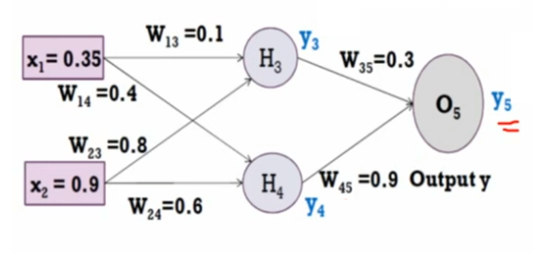








Slide 3
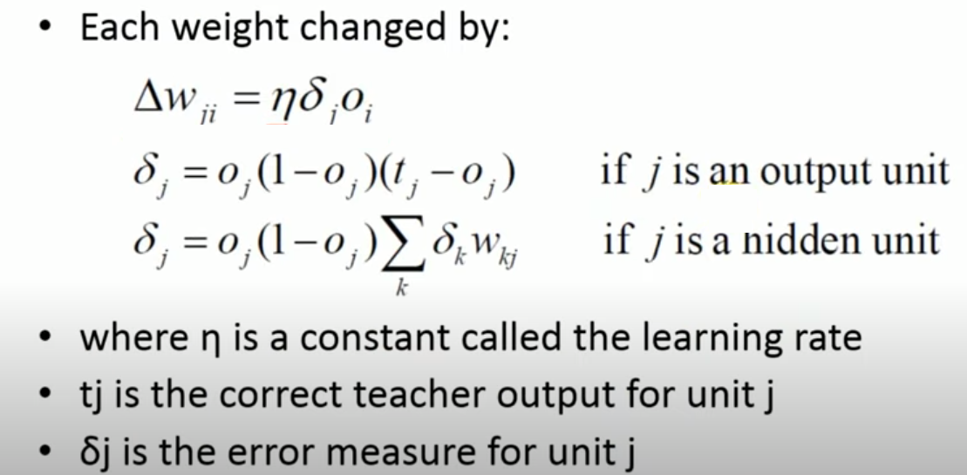
Back Propagation

Slide 4
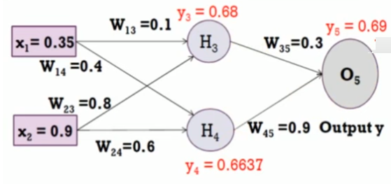





Slide 5
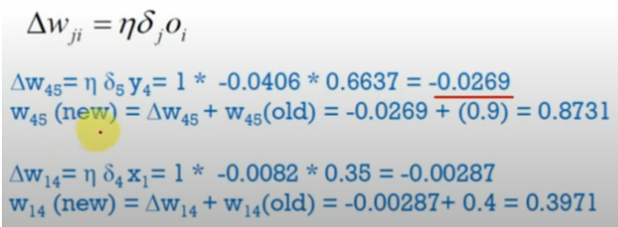

Slide 6
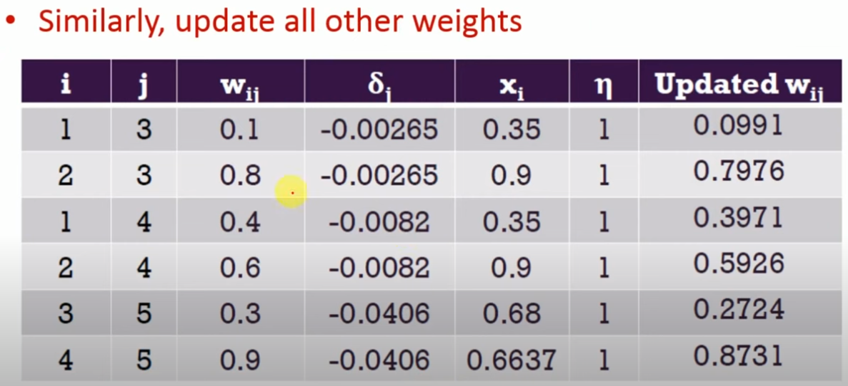
Back Propagation

Slide 7
